Slide 1
Township of Sioux Narrows-Nestor Falls
Tourism Presentation on Mobility Data
November 2023

Slide 2
Presentation Purpose to provide you with an overview of initial tourism data analysis completed by the Township on visitor trends from 2019-2023.

Slide 3
Mobility Data Overview

Slide 4
Human movement data (mobility data) is powerful data on people and places to understand visitation patterns, visitor origin, consumer profiles and more.

Slide 5
Mobility Data (Human Movement data)
What is it?
GPS Data that is gathered from smartphones and devices by Near (data company)
It is collected when an individual uses one of 40 unidentified applications
Navigation, weather, social media, news, and other applications
Every time a user downloads one of the apps, they can agree or not to allow tracking of their location/data (most just agree)
Every time a someone uses an app, it records location data (sends a Ping to Near!)
No personal identification shows up in the data, each “user” is given a long cryptic ID
The data is sold by Near to a range of customers who use it for different data driven analyses for tourism, economic development, transportation and more!

Slide 6
Mobility Data (Human Movement data)
Mobility data can be used to analyze the “Tourist Profile” of a destination, including:
Place of Origin: Where are our tourists from?
Length of Stay:
How long do our tourists stay?
Visitation Patterns:
What are the top points of interests tourists visit?
Event Analysis:
How do events impact visitation to the area?
Demographics:
Postal Code/Census areas of our visitors.
Focus of presentation!

Slide 7
Mobility Data (Human Movement data)
Data Use and Limitations
This Data does not account for all visitors/population or provide an exact or precise count!
This Data only includes for mobile device users who recorded data by using one of the apps!
This Data provides a large representative sample that can be analyzed with great confidence!
The Data analysis allows us to analyze and report using “proportions/trends” that we can assume are reflective of real conditions!

Slide 8
Mobility Data (Human Movement data)
Key Data Points Used for Township Analysis
Common Evening Location (Home) – place where a smart phone/device resides for 8-hours each night over at least a 3-month period (home location of the device user)
Visits / Visitors – a “visit” is a recording of a single instance of a unique device (an individual) appearing at a given location at a given time (A single device can may account for one or many visits)
Pin Movements – data points that should specific movements in an area for a unique device (e.g. where do people move and cluster)
Residents and Non-Residents – resident refers to any data point whose “Evening Location” is within the Township municipal boundary vs. non-resident (visitor)

Slide 9
How is the Township Using this data?

Slide 10
How is the Township using this Data?
The mobility data can help answer many different questions about tourism in our community, including:
How has the general rate of visitors to our community trending from 2019 to 2023?
Where are visitors to our community coming from (e.g. domestic vs international) during key tourism season weekends?
Has the home location of visitors to our community during key tourism season weekends changed from 2019 to 2023?
For example, are we seeing higher/lower rates of visitors from certain areas?

Slide 11
Visitor Analysis Overview
Weekends Analyzed (2019-2023)
The following weekends for 2019, 2021, 2022, and 2023 were analyzed:
May (Fathers Day Weekend)
July (Canada Day Weekend)
July (Second Weekend)
August (Long Weekend)
August (Third Weekend)
September (Weekend after Labour Day)
October (Thanksgiving Weekend)
The Township purchased full year data for 2019, 2021, 2022, and 2023.
2020 was skipped due to the impacts of COVID-19.

Slide 12
Data Summary
There was a sizable increase in the number of unique ID’s registered for all of 2023 as a result of improved data collection by Near and increased traffic through the Township (not all attributed to new visitors)
The number of unique IDs registered for the key weekends analyzed grew by 42%, some which can be partially contributed to growing visitor numbers
As a result, the 2023 analysis looks at the proportion (%) of home locations of visitors (e.g. Canada vs USA) for 2019-2023 versus total number
Reminder: This is a large representative sample that does not reflect the actual or absolute number of visits of visitors.
Targeted Weekend Unique Devices

Slide 13
2019-2023 Analysis Home locations of our Visitors

Slide 14
National Heat Map – Evening “Home” Location of Visitors 2019-2023
2019
2021
2022
2023

Slide 15
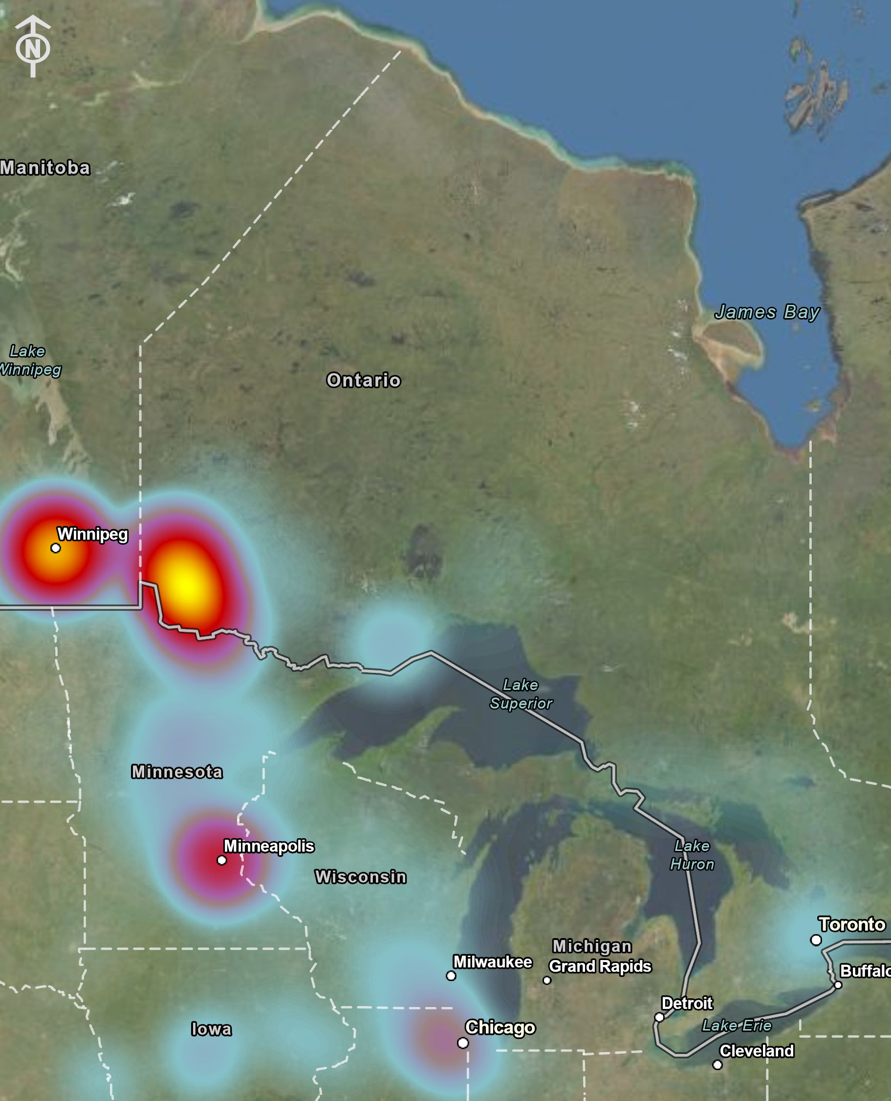
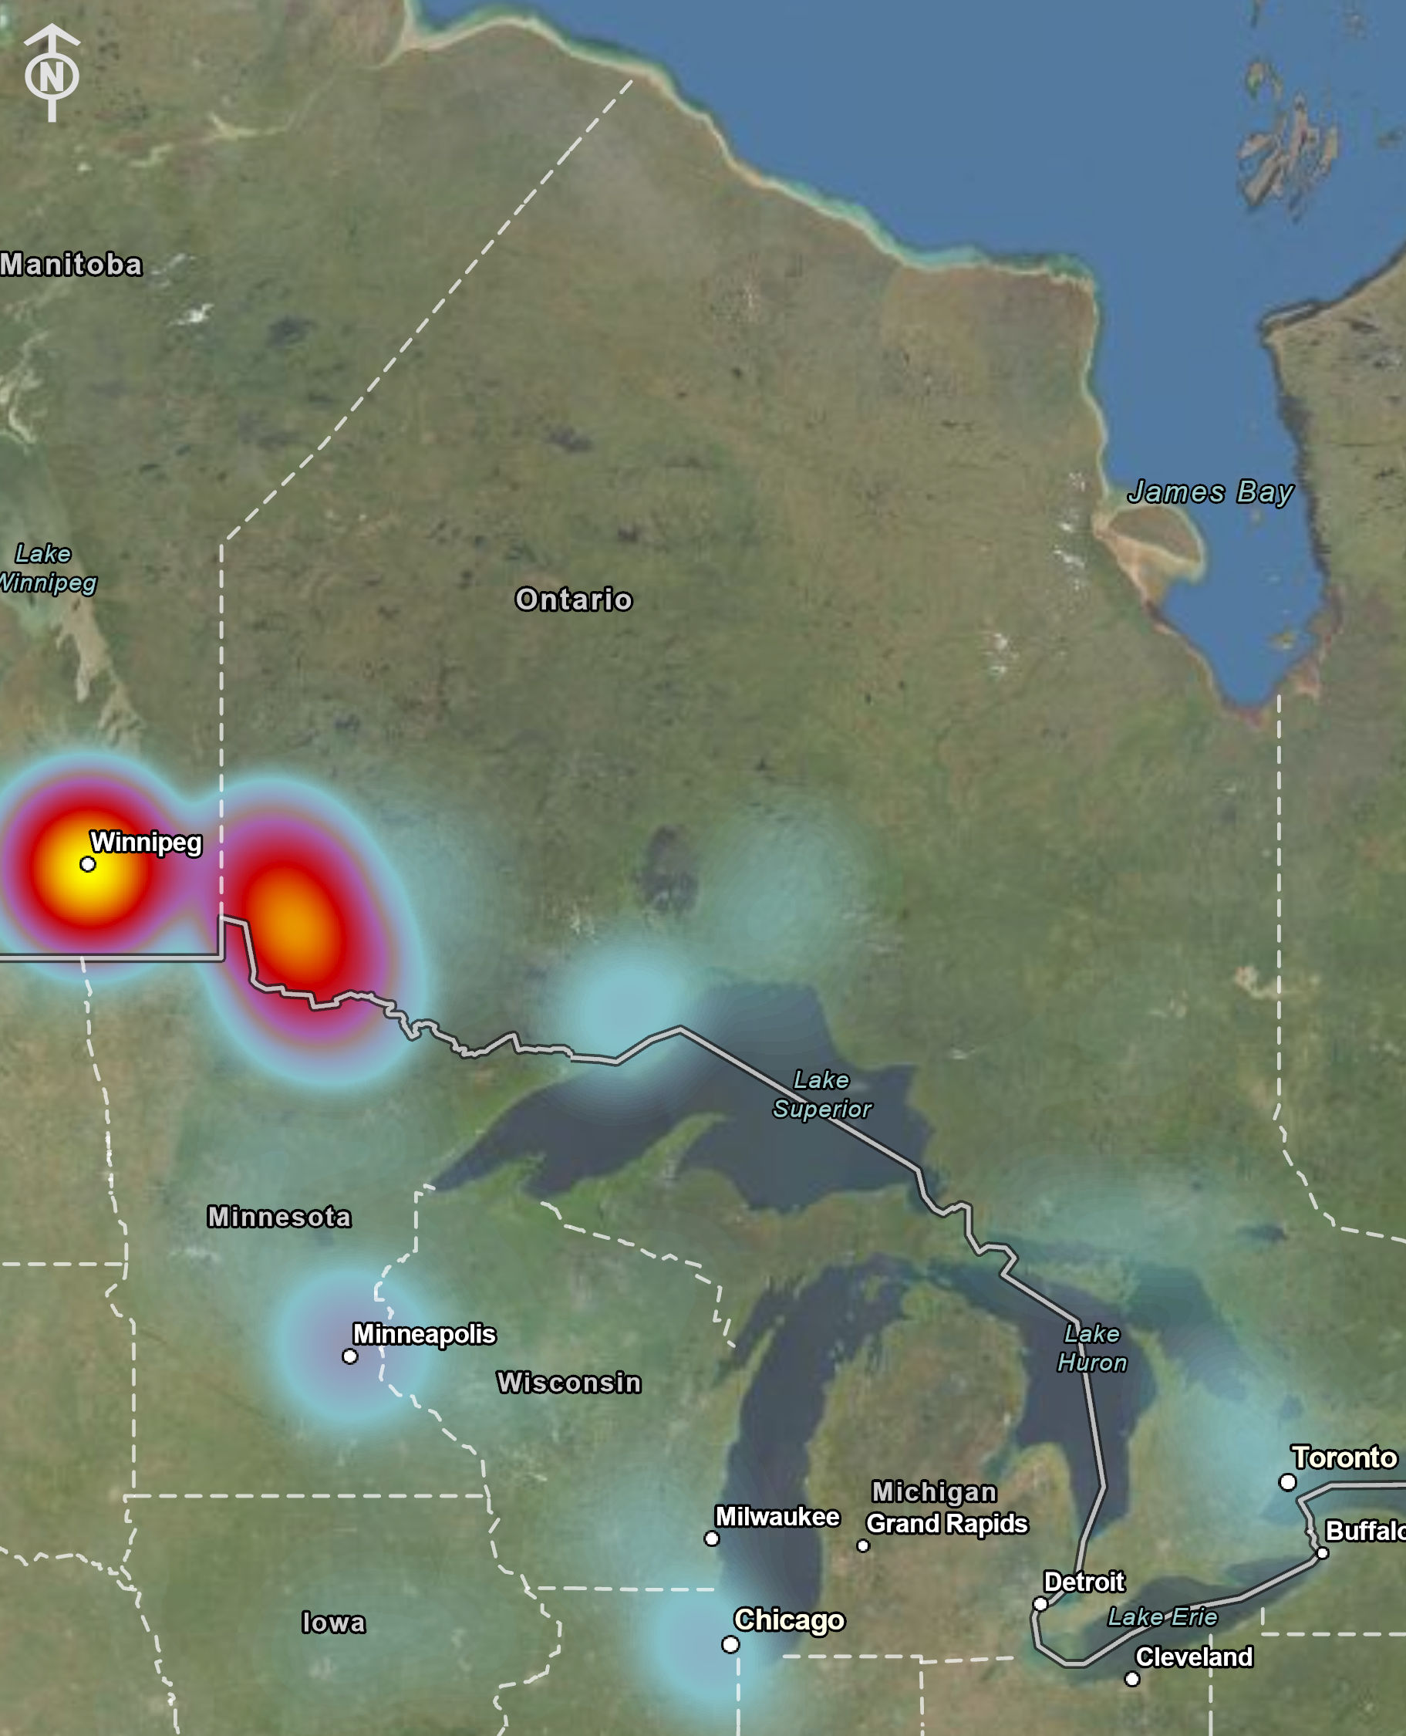
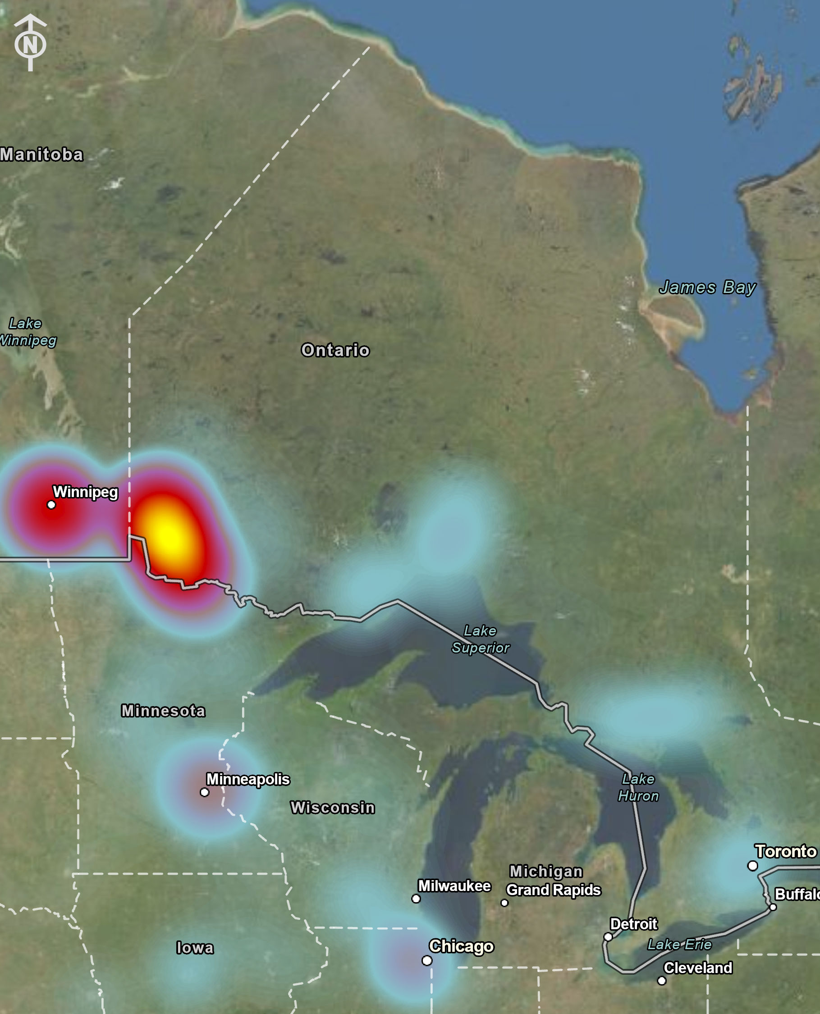
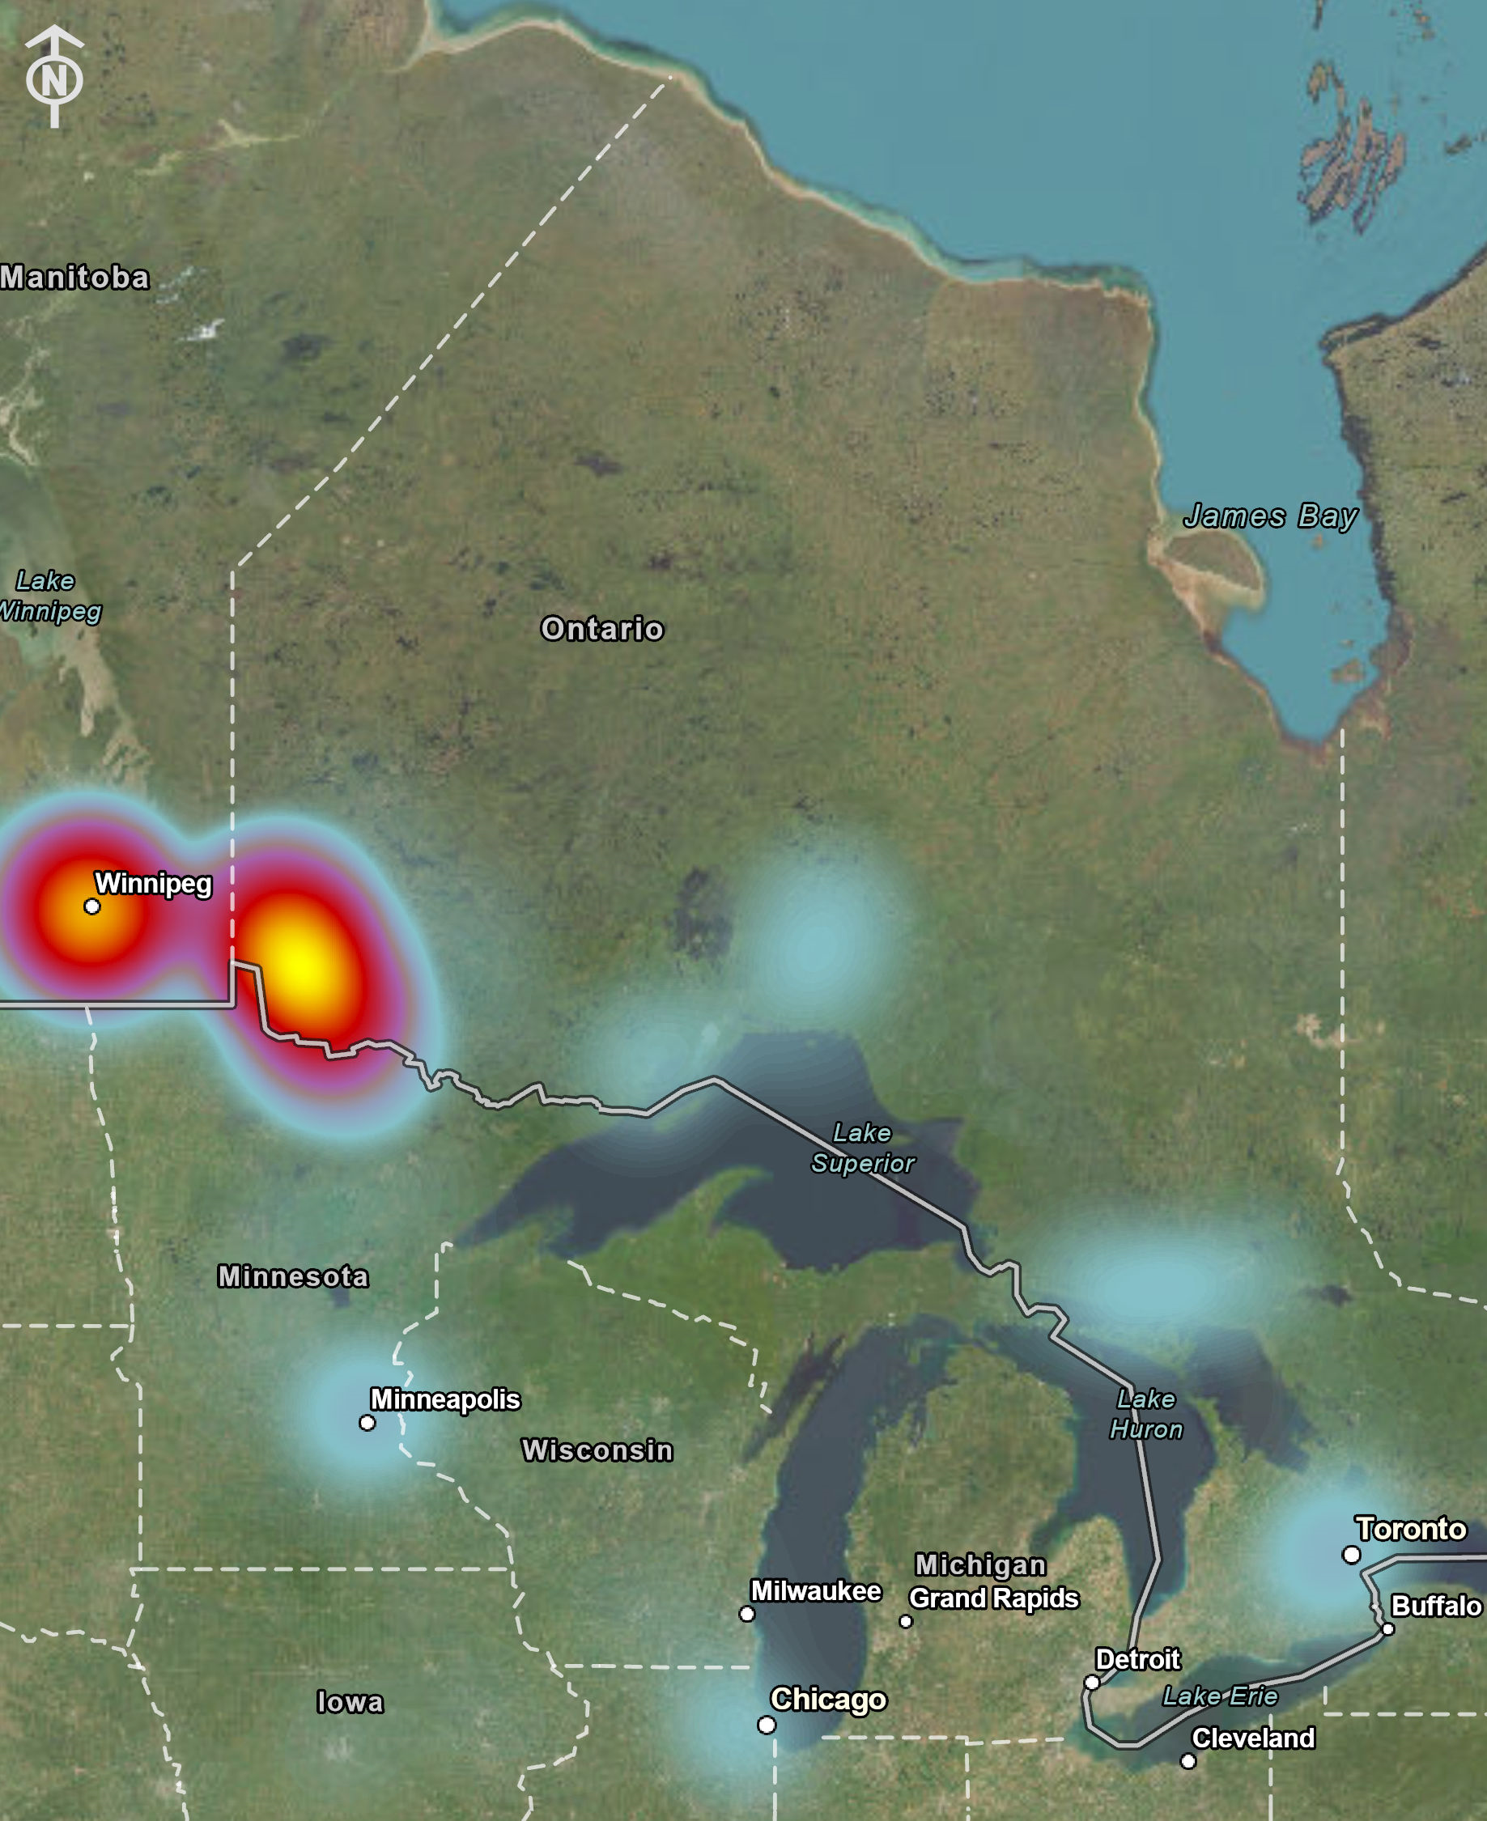
Regional Heat Map – Evening “Home” Location of Visitors 2019-2023
2019
2021
2022
2023
Reminder: The heat maps show the proportion specific for each year and not total number!

Slide 16
Canada Unique Devices – 2019 to 2023 Weekends

Slide 17
USA Unique Devices – 2019 to 2023 Weekends

Slide 18
USA vs Canada Visitors (% of total) – 2019 Weekends

Slide 19
USA vs Canada Visitors (% of total) – 2021 Weekends

Slide 20
USA vs Canada Visitors (% of total) – 2022 Weekends

Slide 21
USA vs Canada Visitors (% of total) – 2023 Weekends

Slide 22
Canada Visitors (% of total) – 2019 to 2023 Weekends

Slide 23
USA Visitors (% of total) – 2019 to 2023 Weekends

Slide 24
Top 10 Evening “Home” Location of Total Visitors 2019-2023
2019
2021
2022
2023
Common Evening Location | % of Total
Ontario | 25%
Minnesota | 16%
Manitoba | 15%
Illinois | 7%
Wisconsin | 6%
Iowa | 4%
Indiana | 2%
PA | 2%
California | 2%
Texas | 2%
Common Evening Location | % of Total
Ontario | 44%
Manitoba | 27%
Minnesota | 6%
Wisconsin | 4%
Alberta | 3%
Illinois | 3%
Iowa | 2%
Indiana | 1%
BC | 1%
Saskatchewan | 1%
Common Evening Location | % of Total
Ontario | 46%
Manitoba | 16%
Minnesota | 10%
Wisconsin | 4%
Illinois | 3%
Iowa | 3%
Alberta | 2%
Florida | 2%
Indiana | 1%
Quebec | 1%
Common Evening Location | % of Total
Ontario | 50%
Manitoba | 25%
Minnesota | 6%
Alberta | 3%
Wisconsin | 2%
Illinois | 2%
Iowa | 1%
Saskatchewan | 1%
Quebec | 1%
BC | 1%

Slide 25
Top 10 Evening “Home” Locations (City) of Total Visitors 2019, 2022, and 2023
Top Common Evening City Locations in 2019 | % of 2019 Total | % of 2022 Total | % of 2023 Total
Canada
Winnipeg | 10% | 10% | 17%
Kenora | 4% | 8% | 10%
Thunder Bay | 2% | 2% | 3%
Fort Frances | 2% | 3% | 3%
Toronto | 1% | 2% | 3%
USA
Minneapolis – St. Paul | 12% | 7% | 4%
Chicago | 5% | 3% | 2%
Duluth | 3% | 2% | 2%
Fargo | 2% | 1% | <1%
Des Moines | 2% | 1% | <1%
Other communities of note for 2023:
Greenstone (2.5%)
Sudbury (2.5%)
Elliot Lake (1.5%)
Steinbach (1.5%)

Slide 26
Key Takeaways (Trends)
Sizable increases in domestic visitors noted for early weekends (Father's Day and Canada Day) in 2023 compared to previous years
Data analyzed in 2023 from Domestic visitors to the Township during the year and key weekends relatively stable from 2019-2023
7% increase in the share of total visitors from Winnipeg (10% to 17% of total visitors) in 2023 from 2022
Other key growth is visitors within Ontario (e.g. Kenora, Fort Frances, Kenora District, etc.) who are moving more frequently through and in the Township and Winnipeg remaining relatively stable proportionally
Municipality of Greenstone and Sudbury grew as a key visitor home location (2.5% of total in 2023)
The % of USA visitors (share of total visitors) continued to decline in 2023, with the following noted decreases from 2019:
Minnesota (-63%)
Illinois (-71%)
Wisconsin (-66%)
Iowa (-75%)

Slide 27
Thank You! Questions and Comments?
Heather Gropp
Community Development Officer

